Slide 1
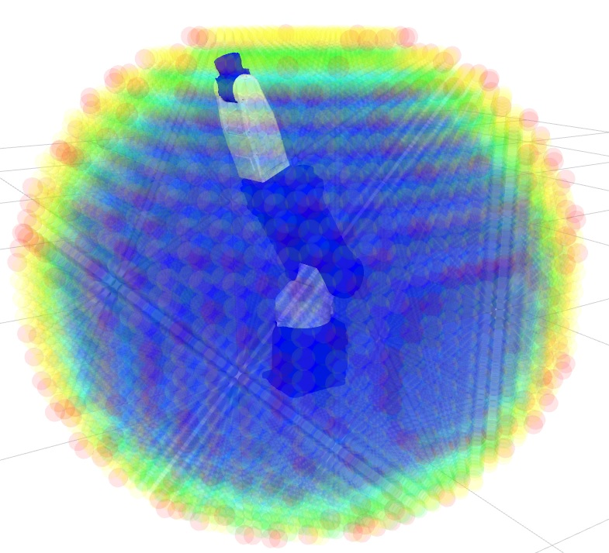
The Reuleaux Library for WorkSpace Analysis
Abhijit Makhal
PhD Student
Idaho State University

Slide 2
Why do we need Analysis of Workspace??
Deduction for the robot/ user about the reachable places
Abstraction for the arm’s capability suitable for task planners, path planners and grasp planners
Where the hand tool center points (TCP) can be easily reached and where not
Visualize directional and structural information about the workspace imposed by robot design
Base placement : Especially for multiple pick and place locations

Slide 3
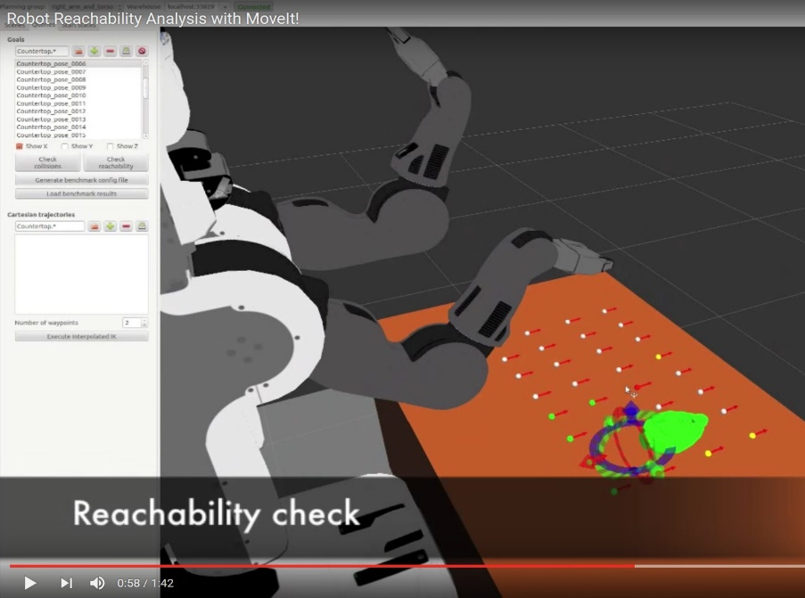
Current Solutions
moveit workspace analysis
https://github.com/ros-planning/moveit_advanced/tree/indigo-devel/moveit_workspace_analysis
https://www.youtube.com/watch?v=OglpJnElgu4
No structural definition of workspace, analysis can only be done by defining end-effector goals
Cannot directly solve base-placement
No stable release
No available documentation
Implementation level – currently not known

Slide 4
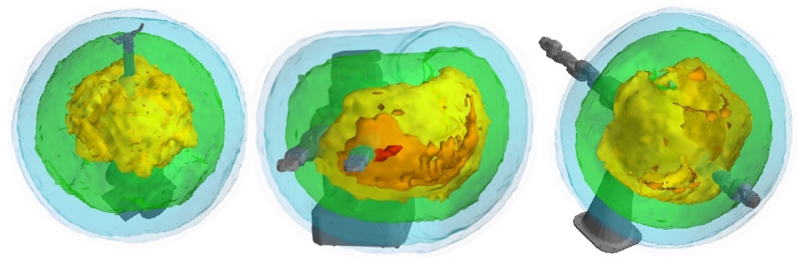
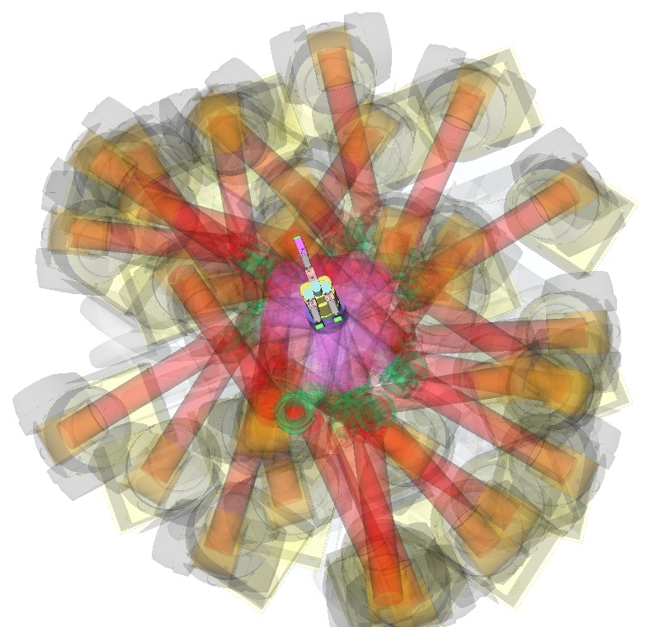
Current Solutions
OpenRave KinematicReachability Module
OpenRave InverseReachability Module
No user-friendly documentation available
No structural synthesis
No user-defined arguments
The data from the map is not reusable for other applications
No ROS-support (openrave_planning package non-existent after ROS Fuerte)
Map generation time for a 6DOF robot varies from 2-3 hours
Size of the map file varies from 150 – 200 mb
Implementation only in base-placement, still the process takes more than 3 hours for single object/grasp location

Slide 5
Current Solutions
DLR method for reachability/capability
No ROS-support
Map generation process takes upto 7-8 hours/ Higher DOF
arm has taken 13 hours
Size of the file of the map 150 – 200 mb
Own custom file structure for maps
User-friendly Documentation available
Structural and directional synthesis available
Implementation in motion planning, grasp planning and
base-placement
http://robotics.estec.esa.int/ASTRA/Astra2015/Papers/Session%206A/96089_Porges.pdf
http://link.springer.com/chapter/10.1007%2F978-3-319-03653-3_50

Slide 6
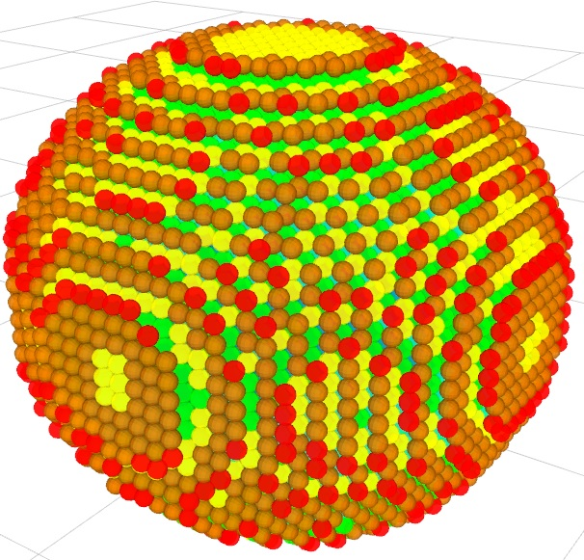
Our Method
OpenRave KinematicReachability + DLR method
REULEAUX
ROS-support
Structural and directional synthesis
Based on existing ROS structure and robot representations
Scope of user argument as per application needs
Easily readable map structure
Map size ranges from kb-25 mb
Approximate map generation time ~ 5-15 min
Can be easily extended to applications such as grasp planning, motion planning or base-placement

Slide 7
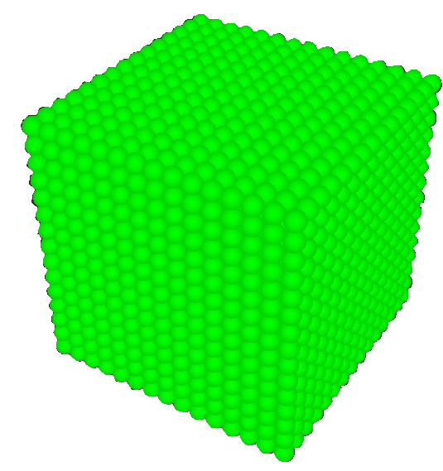
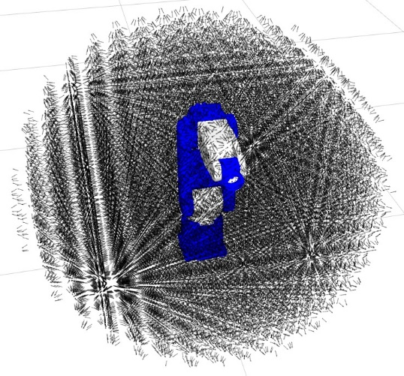
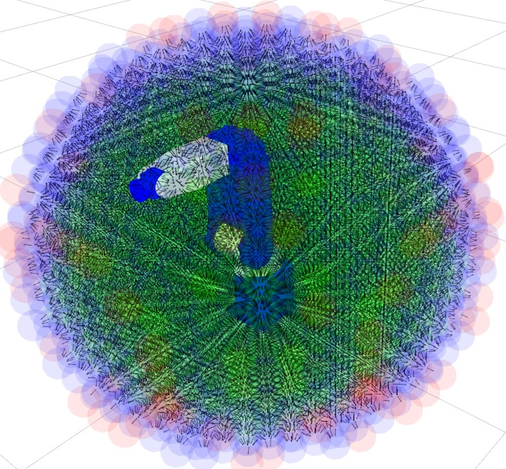
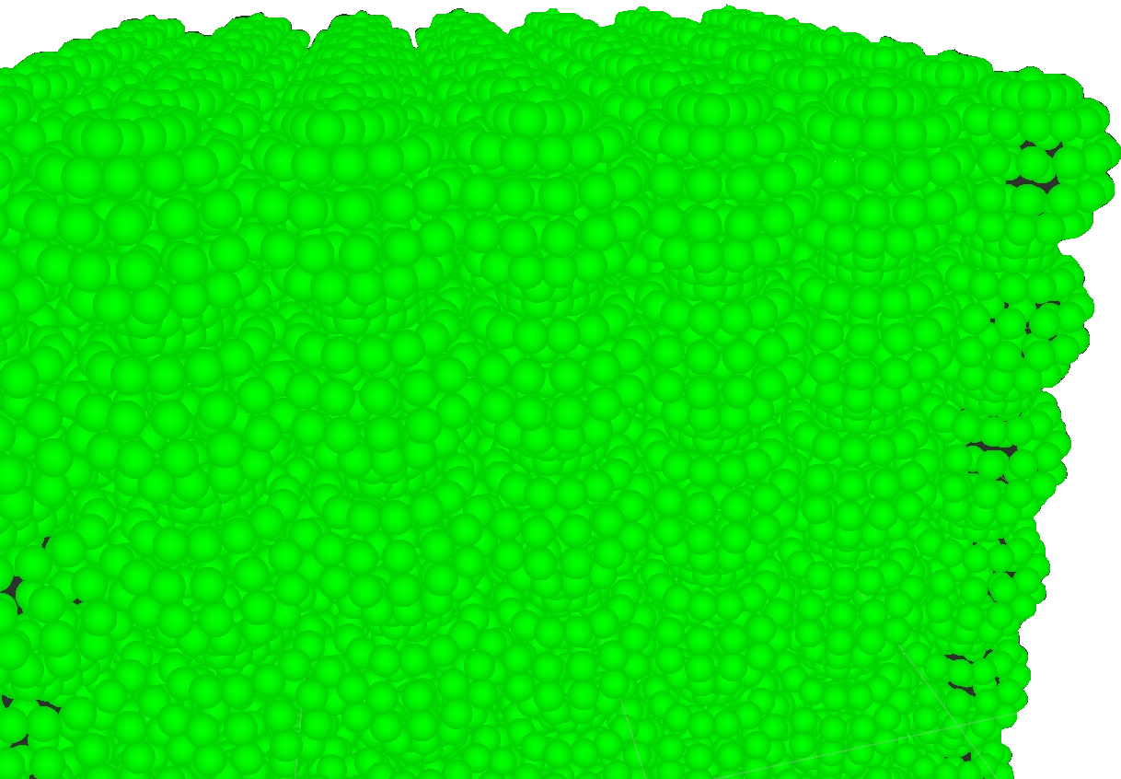
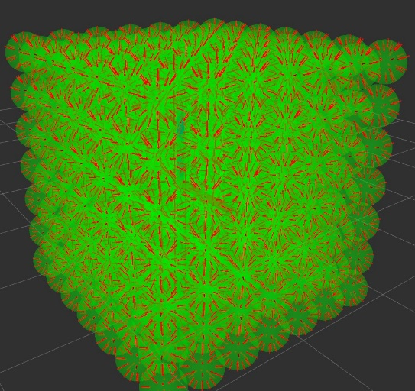
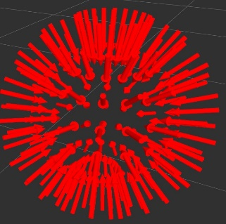
How Reuleaux works?
1
Environment
Voxelization
5
Pose
Filtering
2
Sphere
Discretization
4
Pose
Collection
3
Pose
Generation

Slide 8

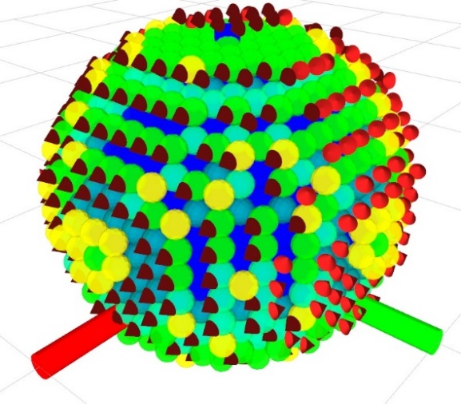
How Reuleaux works?
Reachability Map
Stores All the Filtered Sphere Coordinates and Reachable Poses
Based on Reachability Index
R = Number of valid Ik solutions on the Sphere
N = Total number of Poses on the Sphere
Capability Map
Captures the directional information
For the outer spheres try to fit a cone with Shape Fir Error(SFE)
R = Number of valid Ik solutions on the Sphere
r = Number of poses the cone fails to cover
u = Number of poses the cone wrongly covers
[ 1]
[ 1]
[1] F. Zacharias, C. Borst and G. Hirzinger, "Capturing robot workspace structure: representing robot capabilities," 2007 IEEE/RSJ International Conference on Intelligent Robots and Systems, San Diego, CA, 2007, pp. 3229-3236.doi: 10.1109/IROS.2007.4399105

Slide 9
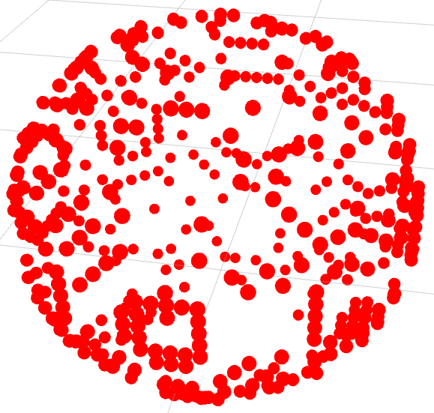
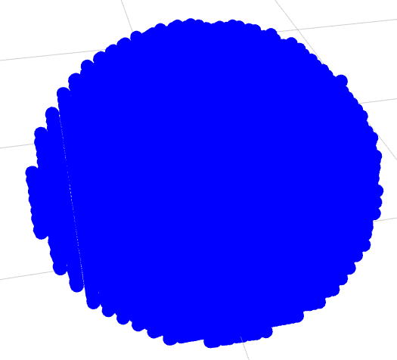
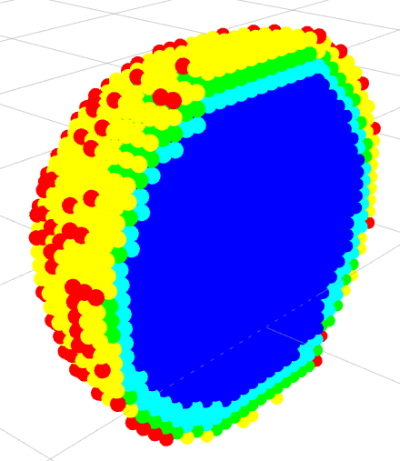
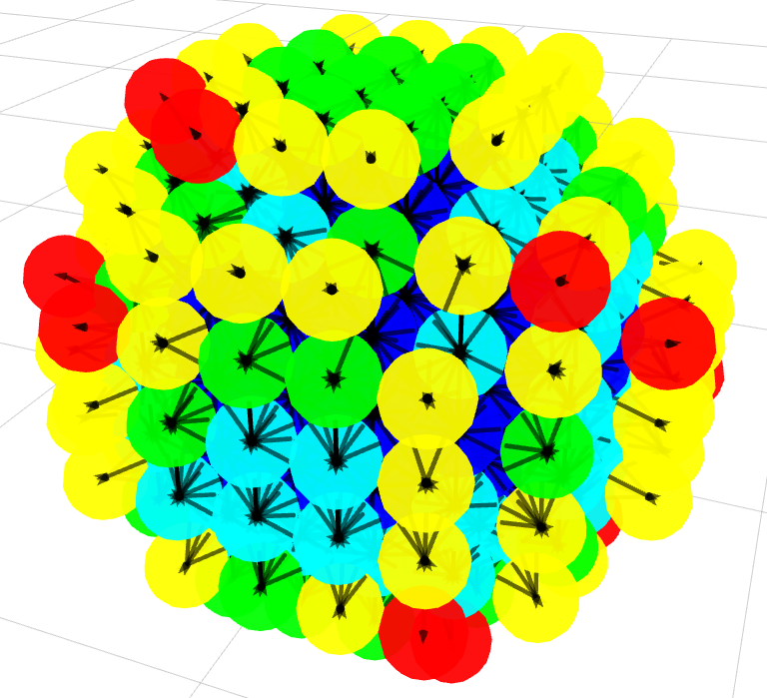
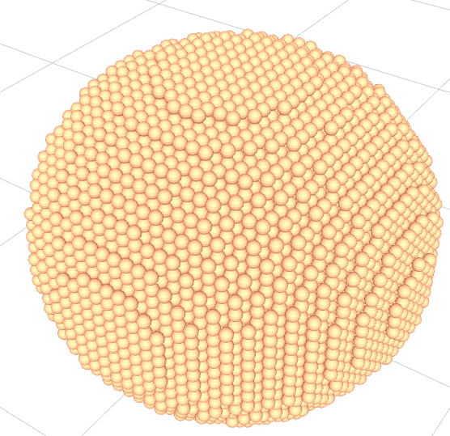
Visualization
By Reachability Index
Dissections
Change Sphere Color
Show Reachable Poses

Slide 10
Results
Reachability Map
Resolution | Number of Voxels | # of Reachable Spheres | # of Reachable Poses | Time | File Size
0.5 | 64 | 8 | 71 | 0s | 10.9 kb
0.25 | 343 | 35 | 541 | 1s | 30.6kb
0.1 | 3375 | 294 | 8423 | 1s | 354.2kb
0.08 | 6859 | 543 | 16527 | 3s | 686.3kb
0.035 | 79507 | 5536 | 196568 | 29s | 8mb
0.025 | 226974 | 14652 | 538910 | 95s | 22mb
Capability Map
Resolution | # of Reachable Spheres | Time | File Size
0.5 | 8 | 42s | 3.1 kb
0.25 | 35 | 106s | 5.2kb
0.1 | 294 | 412s | 26 kb
0.08 | 543 | 731s | 45.9kb
0.035 | 5536 | 5012s | 445.3kb
0.025 | 14652 | 11939s | 1.2mb

Slide 11
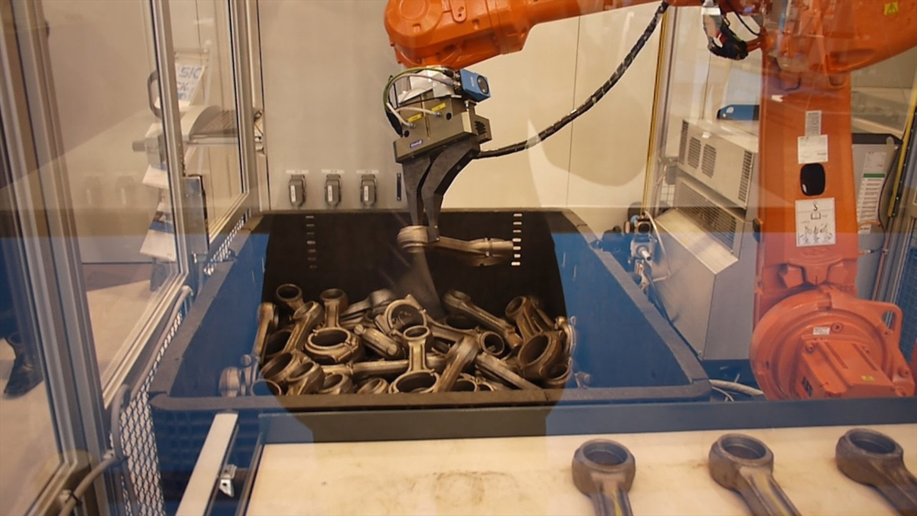
Future Work
Project Continuation:
Base Placement for specific tasks by Inverse Reachability
Potential Future works
Better Visualization
Support for 7+ dof robots
Singularities, Joint Limits
can you place the robot/object in such a way so as to avoid/minimize object refixturing?

Slide 12

https://github.com/ros-industrial-consortium/reuleaux
Questions Please

